Slide 1

Turning a Resolution into a Bill
NORTH CAROLINA STUDENT LEGISLATURE | ELON UNIVERSITY

Slide 2

Today’s Agenda
What is a Bill?
Steps of the Process
Formatting Dos and Don’ts
Drafting and Troubleshooting

Slide 3
What is a Bill?
“A bill is the form used for most legislation, whether permanent or temporary, general or special, public or private.”

Slide 4
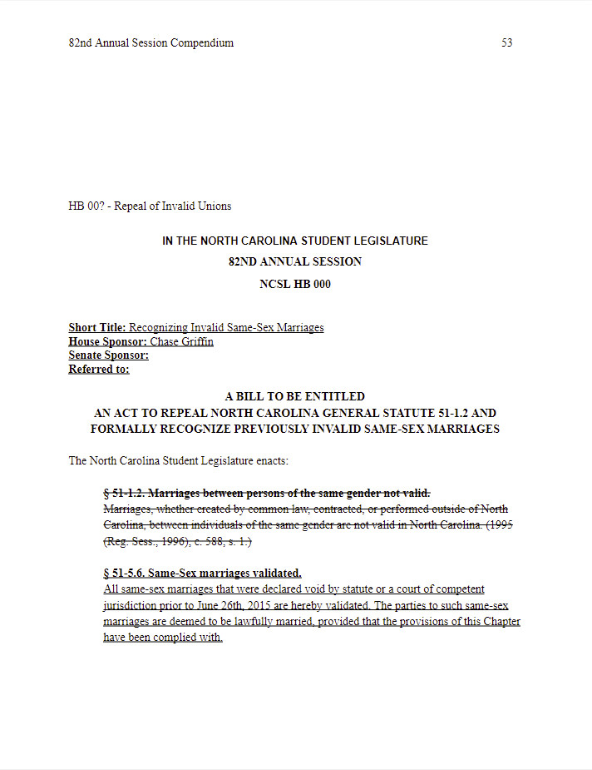
Legislative body; Legislative year; Chamber; Bill number
Short title; Sponsor(s)
Full title
Content of the Bill

Slide 5



Steps of the Process
Identify the relevant statutes
Find what you want to change
Markup the existing law
Getting from a Resolution to a Bill

Slide 6

1. Identify the Relevant Statutes
Where to look
  https://www.ncleg.gov/Laws/GeneralStatutes
  Google (NC ________ laws)
Reading laws
  Look at titles/headings
  Ctrl + F for keywords
What if there is no existing law?
  Where would your bill fit best?
  What laws are most relevant?

Slide 7

2. Find What You Want to Change
Read the existing law
  Be thorough
  Make notes
Think about what needs to be changed
  What do you want to take out?
  What needs to be added?
What if you’re starting from scratch?
  Still read through relevant statutes
  Note the code number that you will be adding to

Slide 8

3. Markup the Existing Law
Out with the old
  Strike through what you want to take out
  Make sure to be consistent throughout
In with the new
  Write the new additions to the law
  Make sure to keep it linear
What if there’s nothing to mark up?
  Write the law from scratch
  Make sure to use wording from the relevant code

Slide 9

Formatting Dos and Don’ts

Slide 10
Correct Markup Formatting
1
2
3
Start with the original text of the existing statute
Use strikethrough to mark text that will be taken out of the law
Use underline to mark text that will be added to the law

Slide 11
Best Practices
Markup bills using Microsoft Word or Google Docs
Do not write your own bill number or chamber code
Follow the examples from past years’ Compendiums
Don’t be afraid to ask for help if you need it
  You can copy/ paste bill text into the document
  Please do not send bills as pdfs
  Numbers/ chambers are decided once all bill are submitted
  The Secretary of State will do this
  Professional/ consistent formatting is very important
  Do not use unique formatting
  The Executive Board and COS are here to help!

Slide 12

Questions?

